Slide 1
DATA ANALYSIS AND VISUALIZATION CSE 2015 MINI PROJECT REVIEW-0

Slide 2
TEAM MEMBERS
HUZAIFA SHARIFF | 20211IST0003
SUGUNASHREE.MK | 20211IST0002

Slide 3
PROBLEM STATEMENT
Analyze customer behavior and preferences on an online food ordering platform, leveraging attributes like Occupation, Family Size, and Feedback.

Slide 4
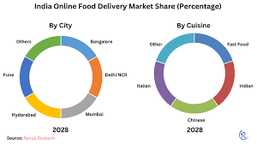
MOTIVATION
The motivation for analyzing online food orders lies in improving customer satisfaction, enhancing operational efficiency, and maximizing profitability for food delivery platforms.

Slide 5
OBJECTIVES
Understand Customer Preferences.
Improve User Experience.
Increase Customer Satisfaction.
Enhance Operational Efficiency.

Slide 6
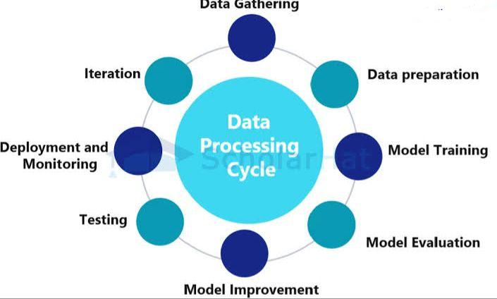
ARCHITECTURE

Slide 7
Thank you

